Slide 1

INVESTIGATING CRIME IN CHICAGO
PROJECT GROUP-C [Tuesday(1pm-3pm)]
1. Canh Thanh Nguyen (45551936)
2. Jarred Reilly (43264204)
3. Soham Sarfare (45812748)
4. Sukhmani Arora (45574715)

Slide 2
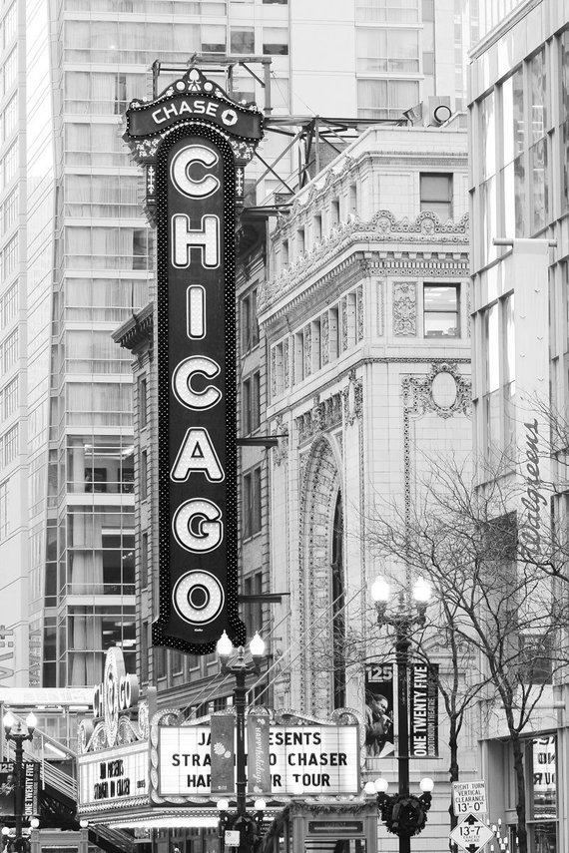
WHY CHICAGO?
Chicago, the third most populous city in the United States of America, has a crime problem.
Violent crime per capita in Chicago is almost three times the national average, and in 2016 the city saw a large surge in homicides while the rest of the nation's crime rates remain near historic lows .
As Chicago is a unique case, we plan to do an investigation into what factors impact crime rates across the city. This is possible because the City of Chicago releases huge amounts of data that's freely available to the public for analysis .

Slide 3
DATA SOURCES
Three CSV files are used:
Chicago Reported Crimes: This dataset contains records of 10 million crimes reported to police in Chicago from 2001 to present.
Chicago Socioeconomic Factors: This dataset contains socioeconomic indicators for all community areas in Chicago. This data is originally from the 2012 Census and contains information like unemployment rate, per capita income, and hardship index.
Chicago Police Stations: This dataset contains the location of all the police stations the city of Chicago. This could be useful to discover if there's positive or negative correlations between the location of crime and location of police stations.
*The above mentioned three datasets have been taken from following respectively:
https://data.cityofchicago.org/Public-Safety/Crimes-2001-to-present/ijzp-q8t2
https://data.cityofchicago.org/Health-Human-Services/Census-Data-Selected-socioeconomic-indicators-in-C/kn9c-c2s2
https://data.cityofchicago.org/Public-Safety/Police-Stations/z8bn-74gv
Notes:
(NFYVP)
National Forum on Youth Violence Prevention
City of Chicago Youth Violence Prevention Plan- Rahm Emanuel
3

Slide 4

DATA PREPARATION:
Extensive data preparation is planned to ensure quality data for our later analysis. The following steps are performed:
1. Analyze the data for missing values or duplicates and apply techniques to remedy these where appropriate.
2. Combine Chicago crimes, socioeconomic, and police station datasets.
3. Investigate the distribution of variables within the datasets and handle outliers.
4. The crimes dataset consists of 10 million crimes, so we plan to use a subset of the original dataset (25,000 values). Depending on the distribution results we may do this randomly or try to improve the representation of values in the subset.
5.The main file used for maximum analysis is ‘Chicago-merged.csv’.
Notes:
(NFYVP)
National Forum on Youth Violence Prevention
City of Chicago Youth Violence Prevention Plan- Rahm Emanuel
4

Slide 5

PROBLEM STATEMENT AND GOALS
The main goal of this project is to perform analysis of the factors which influence the crime occurrence in Chicago. This is done by modelling and visualisation techniques.
While we won't be finding any solutions to these problems Chicago, but we do hope to bring to light some of the key factors affecting the city's crime problem.
Our main area of analyzing crime is based on violent and non violent crime in Chicago.
Notes:
(NFYVP)
National Forum on Youth Violence Prevention
City of Chicago Youth Violence Prevention Plan- Rahm Emanuel
5

Slide 6
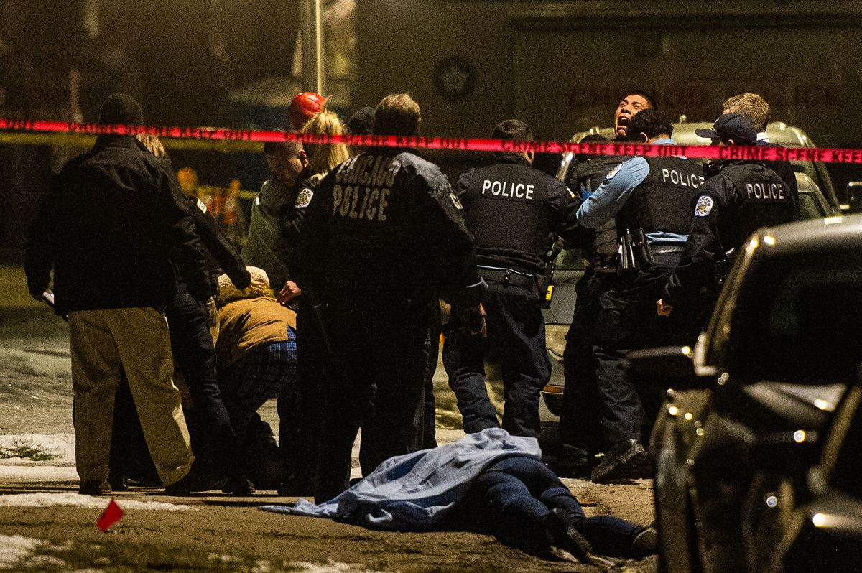
PERFORMING ANALYSIS
Analysis has been done using following :
Correlation matrix/pair-plot has been made to see whether there is an correlation between factors.
Perform regression analysis linking economic factors to number of crimes or crime rate if we can get population data.
Based on location (latitude, longitude) we want to find which crime is most likely in that area using logistic regression, support vector machine, neural network, random forest regressor.
Time series analysis has been performed on the data: We have tried to fit ARIMA model with respect to number of crimes and time of year and/or area. This will help us in predicting number of crimes that may happen in the next year.
Visualising the distribution of a few variables(community area, socio economic metrics) which have numerical values, using boxplots.
Notes:
(NFYVP)
National Forum on Youth Violence Prevention
City of Chicago Youth Violence Prevention Plan- Rahm Emanuel
6

Slide 7
PERFORMING ANALYSIS CONTD…
6. Exploring the geographical distribution of various factors affecting the crime rate in Chicago, and determining whether there is correlation between those factors and the crime rate using geopandas heatmaps.
7. Plots have been made to show number of crime occurring according to their type.
8. Bifurcating the crime into violent and non-violent crime, using one hot encoding, creating train and test data and performing regression analysis, K nearest neighbours, neural network, and hence predicting violent and non-violent crime from the data.
Notes:
(NFYVP)
National Forum on Youth Violence Prevention
City of Chicago Youth Violence Prevention Plan- Rahm Emanuel
7

Slide 8
Preparing Data: Garbage in, garbage out
One-hot encoding
Locations: North Side, South Side, East Side, West Side
Encoding of East Side: [0, 0, 1, 0]
Ordinal encoding
Arrest values: True, False
Encoding of False: 0
Binning
Longitude range: -87.9 to -87.5
Encoding of -87.85: [1, 0, 0, 0, 0]
Notes:
(NFYVP)
National Forum on Youth Violence Prevention
City of Chicago Youth Violence Prevention Plan- Rahm Emanuel
8

Slide 9
Predicting Location of Crime
Example input: A robbery, at night, on the sidewalk, on the weekend
Task: Predict where that crime will take place
Label: a poor, moderate, or wealthy area (3-class classification)
Classifiers used:
Logistic Regression (baseline)
Support Vector Machine
K-nearest Neighbors
Neural Network
Notes:
(NFYVP)
National Forum on Youth Violence Prevention
City of Chicago Youth Violence Prevention Plan- Rahm Emanuel
9

Slide 10
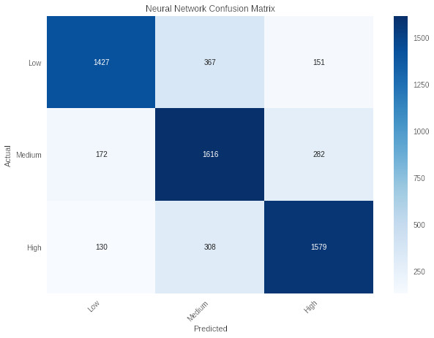
Predicting Location of Crime Results
Test Accuracy Results:
Logistic Regression (baseline): 72%
Support Vector Machine: 69%
K-nearest Neighbors: 71%
Neural Network: 77%
Random chance: 33%
Notes:
(NFYVP)
National Forum on Youth Violence Prevention
City of Chicago Youth Violence Prevention Plan- Rahm Emanuel
10

Slide 11
Predicting Violent Crime
Example input: During the day, in an apartment, in Uptown, on the weekend, and an arrest was made.
Task: Predict whether the crime was violent
Label: true, false (2-class classification)
Classifiers used:
Logistic Regression (baseline)
Support Vector Machine
K-nearest Neighbors
Naive Bayes
Neural Network
Notes:
(NFYVP)
National Forum on Youth Violence Prevention
City of Chicago Youth Violence Prevention Plan- Rahm Emanuel
11

Slide 12
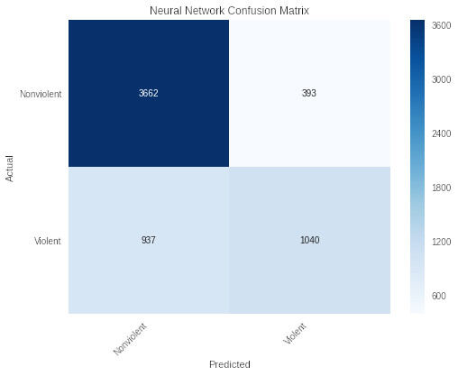
Predicting Arrest Results
Test Accuracy Results:
Logistic Regression (baseline): 77%
Support Vector Machine: 74%
K-nearest Neighbors: 71%
Naive Bayes: 73%
Neural Network: 78%
Random chance: 50%
Notes:
(NFYVP)
National Forum on Youth Violence Prevention
City of Chicago Youth Violence Prevention Plan- Rahm Emanuel
12

Slide 13
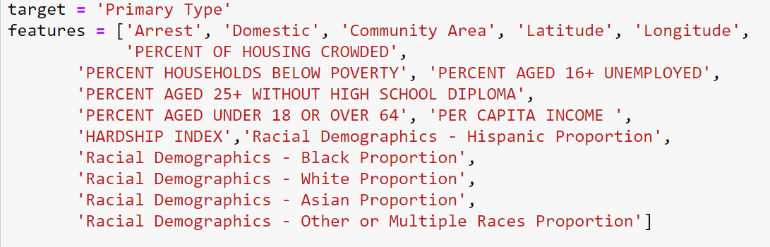
Which type of crime will happen?
Goal: Given a feature vector, we want to know whether it would be possible to predict what type of crime it would be.
Notes:
(NFYVP)
National Forum on Youth Violence Prevention
City of Chicago Youth Violence Prevention Plan- Rahm Emanuel
13

Slide 14
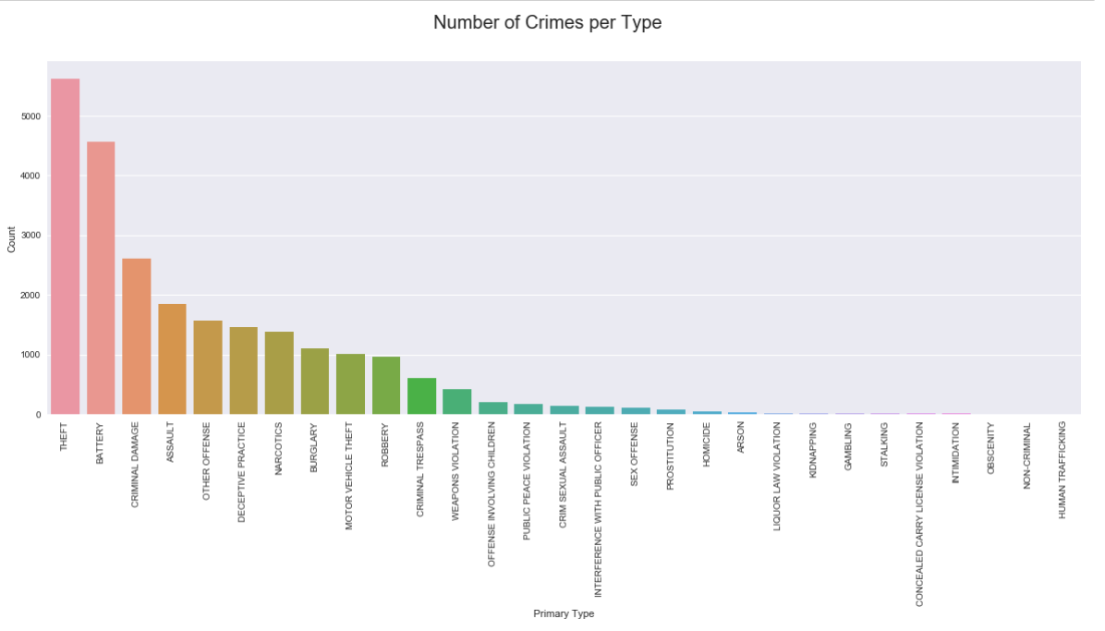
Problem:
- Too many labels - Heavily imbalanced dataset (leaned towards majority label
Notes:
(NFYVP)
National Forum on Youth Violence Prevention
City of Chicago Youth Violence Prevention Plan- Rahm Emanuel
14

Slide 15
Solution:
Reduce number of labels: - Split the data into subgroups
Balance out dataset - Resample: + Under-sample majority labels + Over-sample minority labels - Keep imbalanced data, but add class weights when doing classification models
Notes:
(NFYVP)
National Forum on Youth Violence Prevention
City of Chicago Youth Violence Prevention Plan- Rahm Emanuel
15

Slide 16
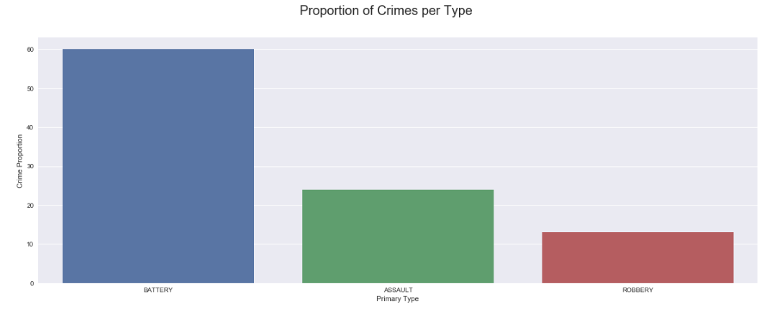
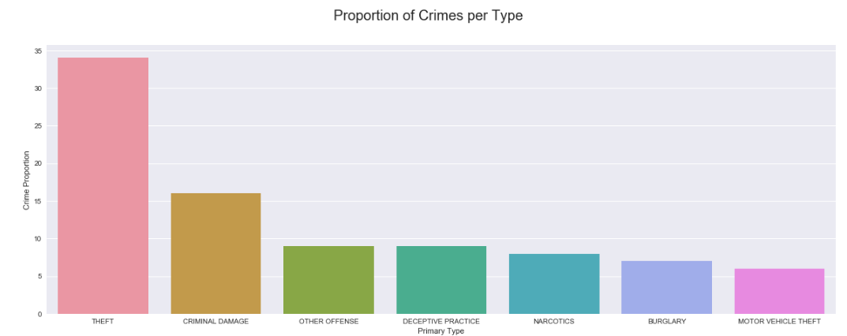
Splitting the dataset into 2 sub-groups

Slide 17
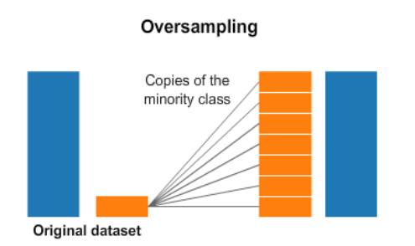
- Re-sampling Techniques
Oversampling: - SMOTE (Synthetic Minority Oversampling Technique): Generating synthetic datapoints to balance out all outcome labels (Type of crime), where the new datapoints will have its 5 nearest neighbours belonging to the same class.
Notes:
(NFYVP)
National Forum on Youth Violence Prevention
City of Chicago Youth Violence Prevention Plan- Rahm Emanuel
17

Slide 18
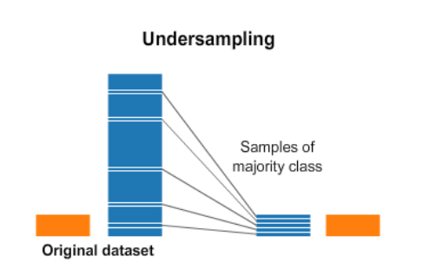
- Re-sampling Techniques
Undersampling: - Condensed Nearest Neighbours: + It selects the set of prototypes (smaller sample) U from the training data, such that 1NN with U can classify the examples almost as accurately as 1NN does with the whole data set. + Given a training set X, CNN works iteratively:
Scan all elements of X, looking for an element x whose nearest prototype from U has a different label than x. - Remove x from X and add it to U - Repeat the scan until no more prototypes are added to U. - Use U instead of X for classification.
Notes:
(NFYVP)
National Forum on Youth Violence Prevention
City of Chicago Youth Violence Prevention Plan- Rahm Emanuel
18

Slide 19
- Re-sampling Techniques
SMOTE-Tomek (combination of over and under-sampling): - Generate synthetic datapoints using SMOTE - Re-move datapoints that share too many similarities (Tomek links)
Notes:
(NFYVP)
National Forum on Youth Violence Prevention
City of Chicago Youth Violence Prevention Plan- Rahm Emanuel
19

Slide 20
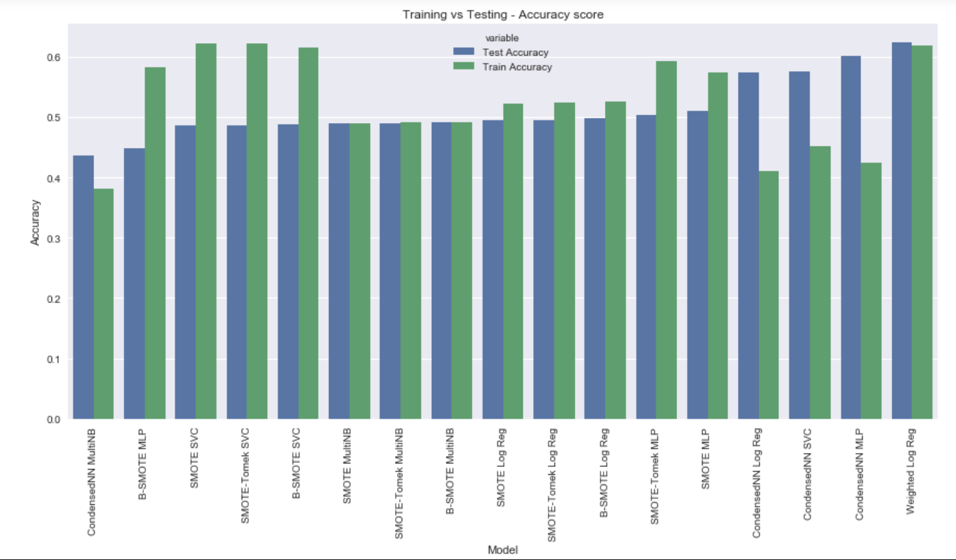
Label prediction for violent crime
Notes:
(NFYVP)
National Forum on Youth Violence Prevention
City of Chicago Youth Violence Prevention Plan- Rahm Emanuel
20

Slide 21
Performance Assessment
In general, resampling algorithms depends very much on the quality of the dataset you have. If you have severe data imbalance, resampling algorithms may be ineffective in generating a high-quality dataset, despite their capability to balance out the dataset.
This could largely be due to the similarities between the two minority classes being very high (and hence the oversample resulting in low-quality repetitive data), despite them being acceptably close in terms of total occurrences' proportion.
To determine that this is the case, we will try to train a classification model on the minority classes (which are not as strongly skewed towards any class as the dataset above) and check the results if the classification accuracy remains low despite the relatively balanced dataset.
However, it could also be the case that we have too many irrelevant predictors. We will also be performing dimensionality reduction based on feature importance
Notes:
(NFYVP)
National Forum on Youth Violence Prevention
City of Chicago Youth Violence Prevention Plan- Rahm Emanuel
21

Slide 22
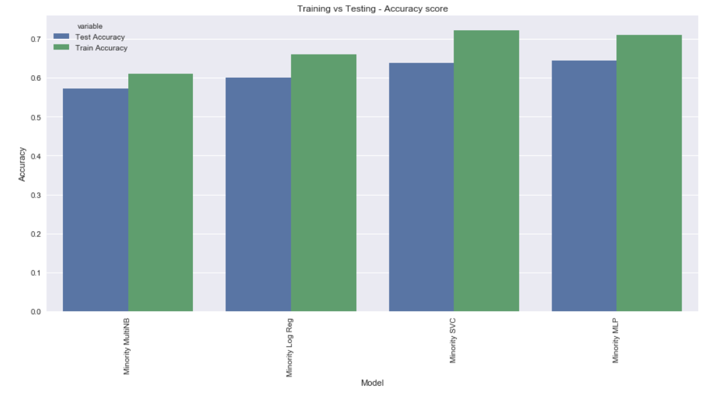
Minority Classes Prediction
As suspected above, despite having a relatively "balanced" dataset, the models still perform poorly, even more so comparing to the logistic regression model with the original imbalanced dataset
Notes:
(NFYVP)
National Forum on Youth Violence Prevention
City of Chicago Youth Violence Prevention Plan- Rahm Emanuel
22

Slide 23
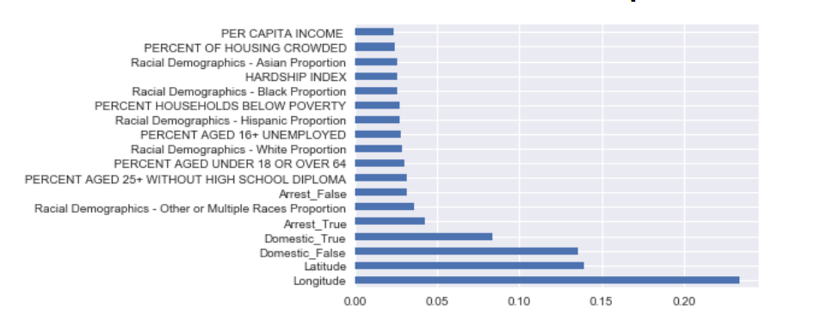
Feature Selection
Using the top 5 features from Extra Trees Classifier (since it is one of the few classification models that have feature importance)
Notes:
(NFYVP)
National Forum on Youth Violence Prevention
City of Chicago Youth Violence Prevention Plan- Rahm Emanuel
23

Slide 24
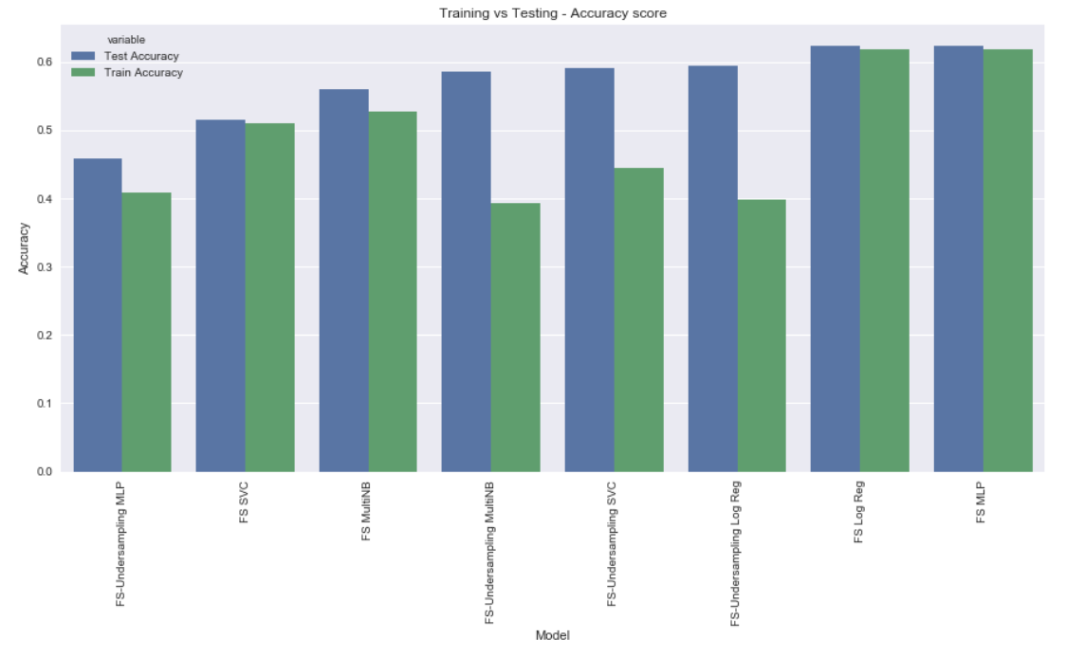
Feature Selection – With and Without resampling
Looking at the accuracy score, we can see that despite the performance of the 4 models still being quite poor, but without resampling, at least they are performing consistently. There are no signs of underfitting or overfitting, however, the dataset is still very much imbalanced.
Notes:
(NFYVP)
National Forum on Youth Violence Prevention
City of Chicago Youth Violence Prevention Plan- Rahm Emanuel
24

Slide 25
Prediction for non-violent crime
Similar trends were seen across different combinations of features and classification models
However, the overall performance was considerably worse than classification for violent crime, since there are much more outcome labels to predict from.
Notes:
(NFYVP)
National Forum on Youth Violence Prevention
City of Chicago Youth Violence Prevention Plan- Rahm Emanuel
25

Slide 26
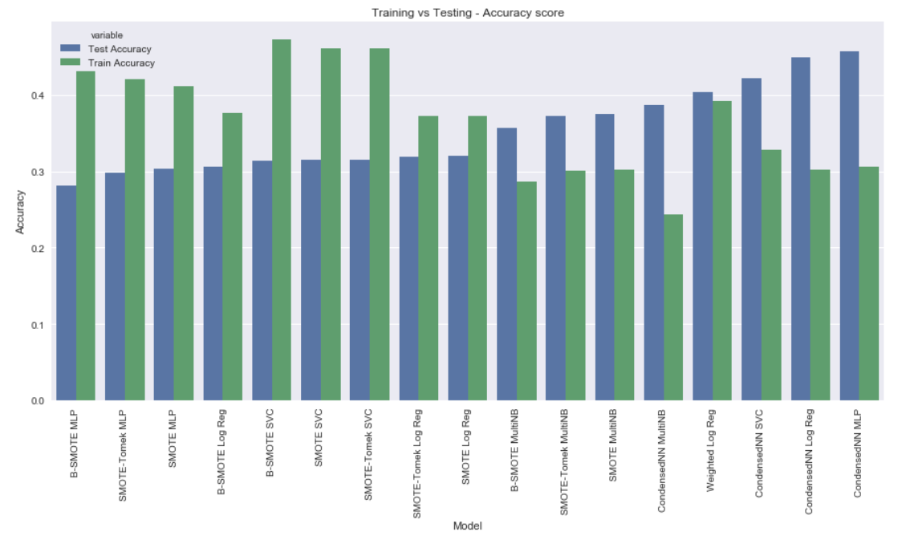
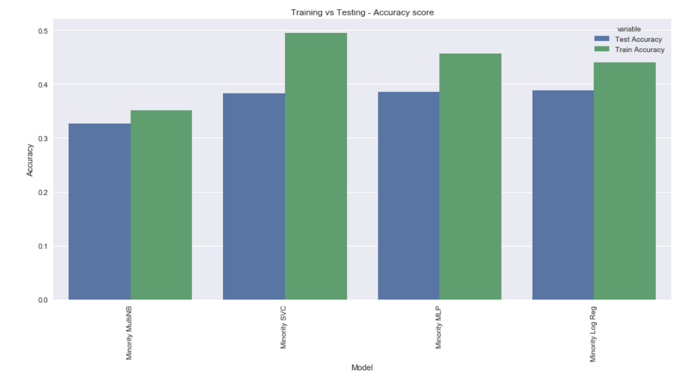
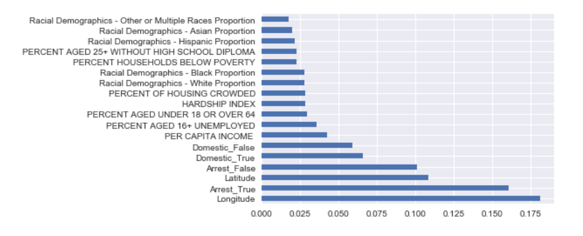
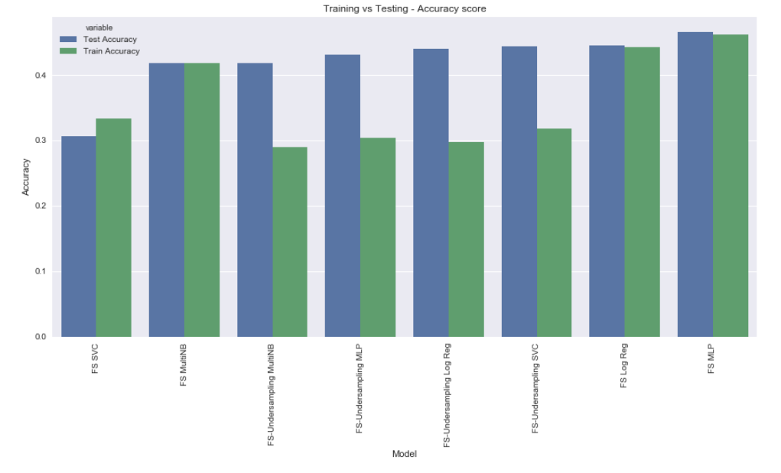
Similar Figures
Notes:
(NFYVP)
National Forum on Youth Violence Prevention
City of Chicago Youth Violence Prevention Plan- Rahm Emanuel
26

Slide 27
Can Socio-Economic Factors predict crimes?
Everyone wants to know the cause behind the number of crimes. Is it because of the economic status of the people in the area? Is it because of the number of schools? So on and so forth.
Hence we test if number of crimes committed in an area are dependant on the Socio Economic indicators of that area.
Crimes committed in that area over the time period of this project are calculated and the current socio economic factors are noted.
A pair-plot is made of number of crimes against every other variable.
The pair-plot shows a random distribution of number of crimes with respect to the other variables indicating that a model may not be feasible.
Notes:
Can socio economic factors predict number of crimes?
To verify this the number of crimes committed in an area are counted and are noted against the areas socio economic factors
The pairplot of crimes against these factors is pretty random
Hence fitting a model may not yield good results
27

Slide 28
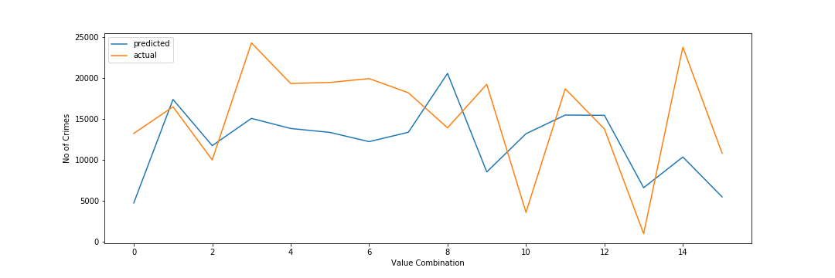
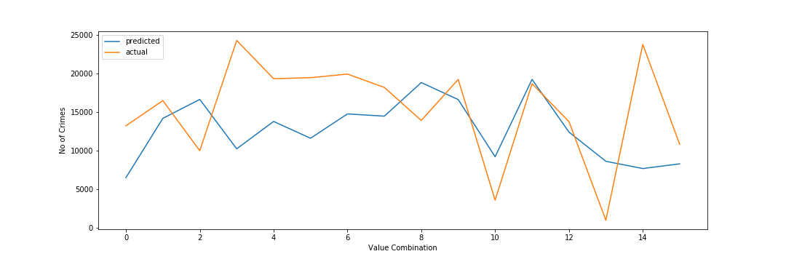
Comparing Various Models
After splitting the data in training and testing data the following models are tried on it
Linear Model
MLP Regression
R^2 Score on Training Data: 0.3702
R^2 Score on Test Data: -0.2674
R^2 Score on Training Data: 0.1089
R^2 Score on Test Data: -0.2644
Notes:
As we can see, the models fitted give a mediocre r2 score on training data
But an abysmal score on testing data
We can ths say that socio economic factors are not a good way to predict number of cerimes

Slide 29
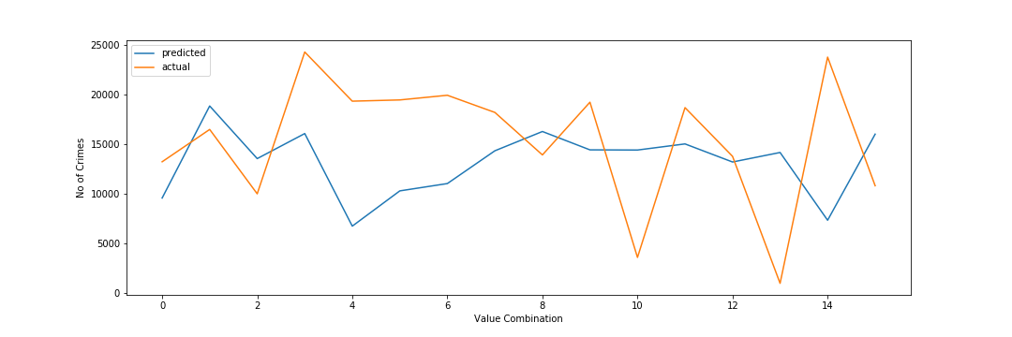
Random-Forest overfitting
R^2 score for train data = 0.8891
R^2 score for test data = -0.6109
Notes:
Random forest in particular overfits itself way too much on the training data with r2 score of .88
Whereas with test data the r2 score is very bad

Slide 30
Predicting No of Crimes Based on Past Crimes
ARIMA modelling is a type of time series modelling which is used to forecast future values based on past information.
Hence we use this modelling technique to predict the total number of crimes in the city of Chicago a year from now.
For ARIMA to work properly we need data going further back in time.
Hence a second sample is taken from the original Chicago Crimes Database, this time considering crimes going as back as 2011
Notes:
Hence we move on to time series modelling using ARIMA
Arima uses past data to forecast future number of crimes

Slide 31
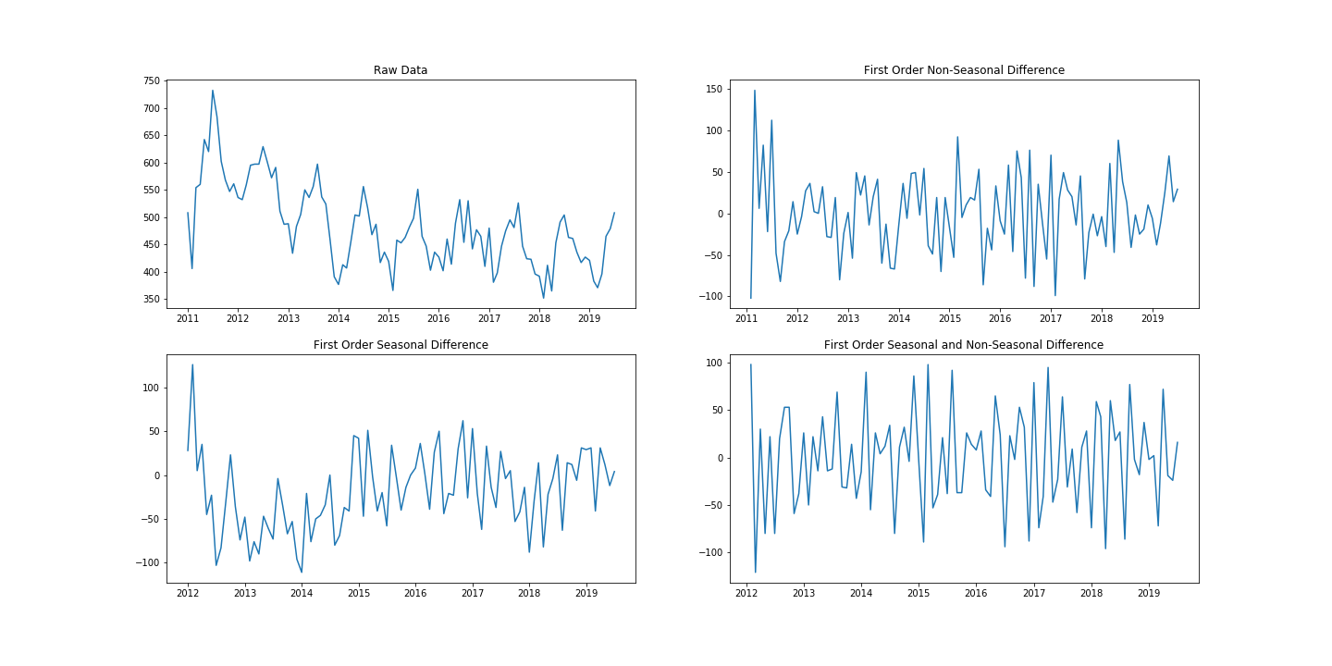
Sequence Charts
Notes:
According to these sequence charts the data obtained from the first order seasonal and non-seasonal transformation looks to be the most stationary
Hence we use this transformation to plot ACF and PACF plots

Slide 32
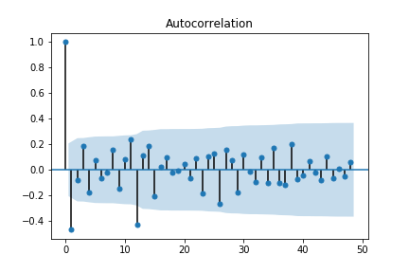
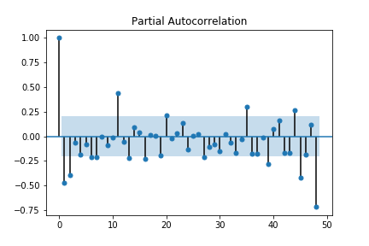
ACF PACF Plot
Notes:
- ACF plot is gradually decreasing whereas the PACF plot shows sig cutoff at lag 3 with a seasonal component at lag 12

Slide 33
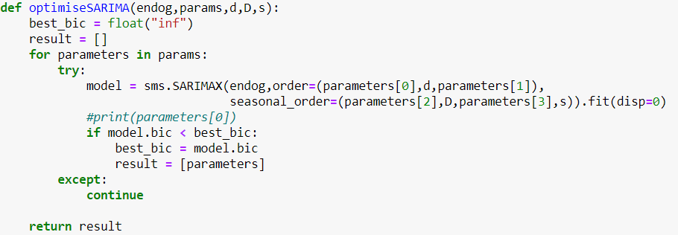
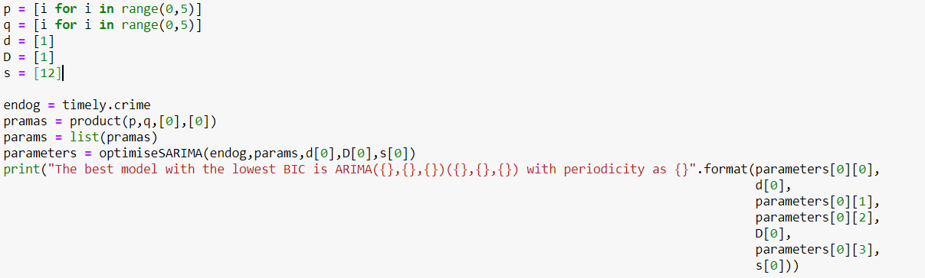
Choosing the best model
To take out the human part of this model, we use the model that gives the least value of BIC. The following code automates this process for us.
The optimised model hence obtained is.
Notes:
However to take out the human error factor in this, we automate the factor selection
The model with the least BIC value is chosen
BIC is a statistic that reduces overfitting

Slide 34
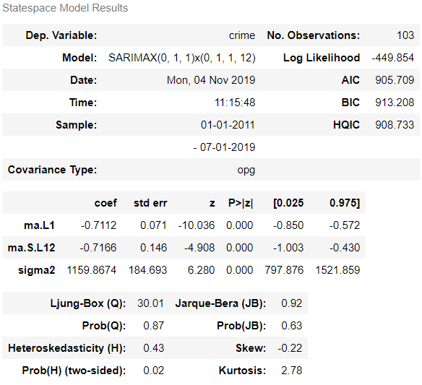
Fitting Model
The best obtained from out function is ARIMA(0,1,1)(0,1,1) with periodicity of 12
We fit the model using the following code:
The summary of this model is:
Notes:
The best model thus obtained is ARIMA 011 011 with periodicity of 12
The model is fitted an the following summary is obtained
As we can see the Box Ljung statistic is non-sig indicating that no more parameters are needed
All the p values of the parameters are significant indicating that they contribute towards the model
Hence this can be considered a good model to forecast values

Slide 35
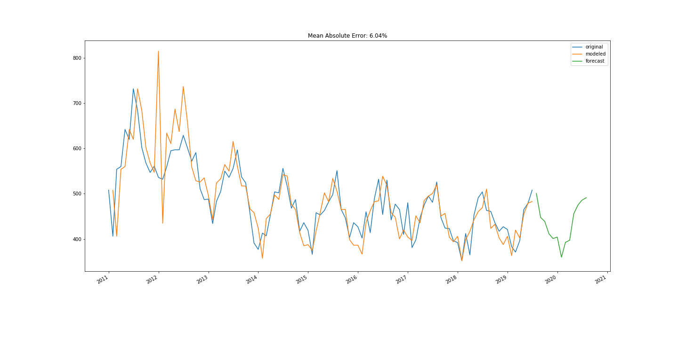
Forecasted Values
Using the predict method the values for Crimes Committed per month are forecasted for a year from now.
Notes:
As we can see from this graph
Blue is the actual number of crimes
Orange is the predicted values according to the model
Except of one spike at the start, the predicted values represent the actual data pretty well
Green are the forecasted values for the next year.

